Slide 1
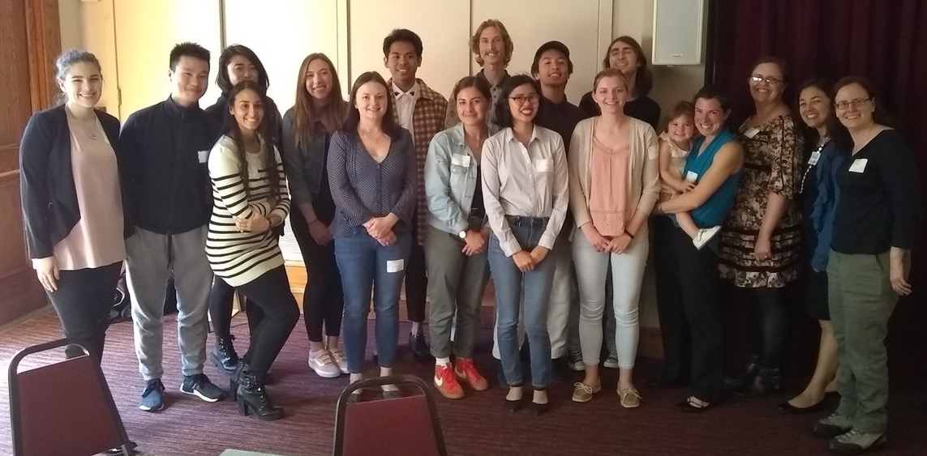

The Learning Assistant (LA) Program at San Francisco State University (SFSU)
Kim Coble
Department of Physics and Astronomy
San Francisco State University

Slide 2
Context of San Francisco State
Student Population and Setting
~30,000 students, master’s granting, Hispanic-serving
Diverse racial/ethnic demographics:
Notes:
History of social justice

Slide 3
Our LA Program
About me
Came to SFSU in Fall 2016 from Chicago State University
Physics & astronomy education researcher, formerly cosmologist
Working with LAs since Spring 2005
LA program started in Spring 2017
Physics, Astronomy, Chemistry
With Alegra Eroy-Reveles (now at UCSC, Chemistry)
Started with 6 courses, 7 instructors , 11 LAs, ~1000 students
Currently ~ 18 sections, ~ 12 instructors, ~ 25 LAs, ~ 2000 students per semester
Planned expansion in Fall 2021: Math, Computer Science
Notes:
Bio has PALS

Slide 4
Program Elements: Follows LA Alliance Model
Help facilitate active learning in class
Mainly large intro “lecture” classes (50 – 150 students); but flexible
Most instructors who teach the intro phys/astro/chem courses have participated; many are lecturers
All intro courses but not all sections have used LAs at some point
Prep with instructor
Wide variety of implementations
LA faculty partnership is where a lot of the magic happens
LA pedagogy course
Equity considerations front and center
Schedule Friday afternoons, can go to either section
Recruit primarily through course instructors (LA mentors)
Notes:
They are not TAs, graders
Harder to recruit for 200-series than 100-series in physics

Slide 5
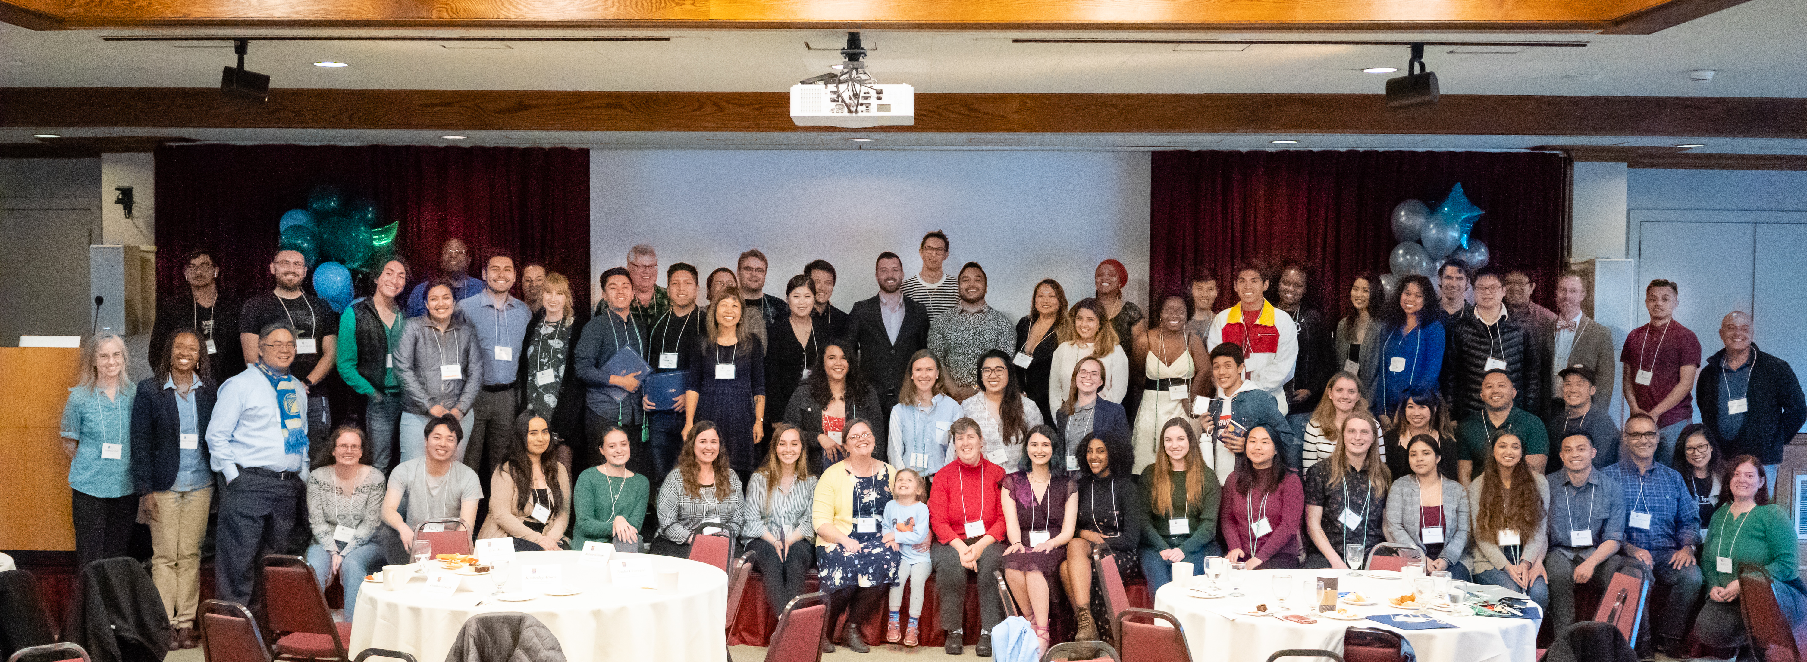
Infrastructure & Support
Very tiny org “chart”
Program director (me)
Coordinators in other disciplines (Rose Lacy, Chemistry)
LA Mentors (instructors who work with LAs in their classes)
Housed in Center for Science and Math Education (CSME)
Other CSME programs include Supplemental Instruction (SI), Teacher Fellows, Math Circles, STEM House, etc. (https://csme.sfsu.edu)
Notes:
By “housed” I mean free food, a room, and companionship

Slide 6
Infrastructure & Support
LAs supported by course credits
Worked with Assoc. Dean of College of Science and Engineering and department chairs
PHYS/CHEM 685: 1 cr, pedagogy course. Meets 1 hr / week + readings, reflections, prep
PHYS/CHEM 686: 1 cr, activity course. 3 hours / week in parent course
Everyone welcome in pedagogy course but only required first time. Can repeat 686 multiple times.
Coordinators get 2 WTUs per semester through these courses
Missing piece: support for LA mentors
Spring 2021: teaching squares
IUSE grant submitted with SJSU Cal Poly SLO
Notes:
LAs are not paid
Easy to add additional 685/686 courses

Slide 7
LA Pedagogy Course

Slide 8
Course Format
Goals
Strategies for facilitating sense-making and promoting learning
Strategies for creating supportive, engaging environment
Readings
How Learning Works (Ambrose et al.)
The Influence of Affirming Kindness and Community on Broadening Participation in STEM Career Pathways (Estrada, Eroy-Reveles, Matsui 2018)
Format
Supportive community
Check-ins, discussions
10 “chapter” reflections + final reflection

Slide 9
Schedule
Intro, Ground rules (community agreements)
Course climate, JEDI
How does students’ prior knowledge affect their learning?
How does the way students organize knowledge affect their learning?
What factors motivate students to learn?
How do students develop mastery?
What kinds of practice and feedback enhance learning?
How do students become self-directed learners?
Notes:
15 weeks

Slide 10
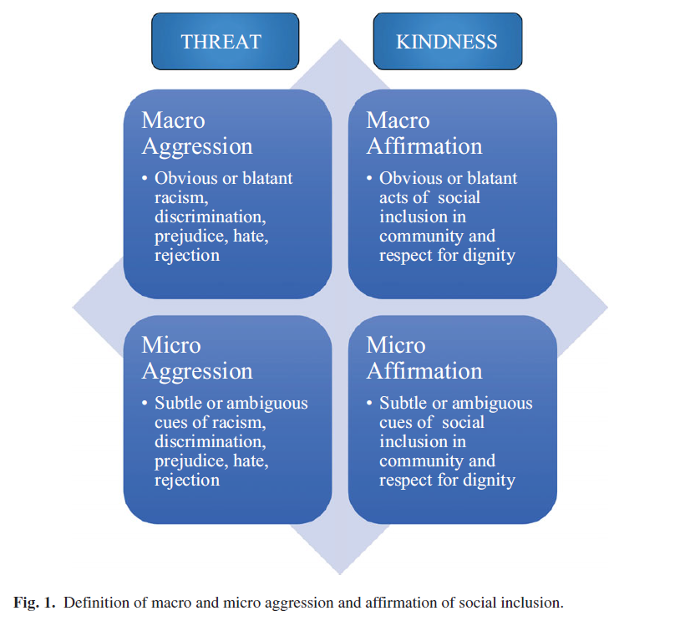
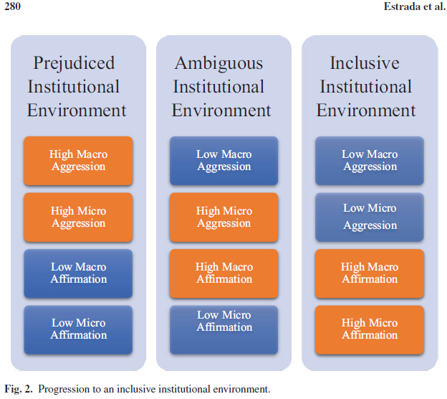
Estrada et al Framing
Plus Table 2: Summarizes theoretical approaches, student challenges to persisting, short-term & long-term recommendations
Notes:
15 weeks

Slide 11
LA and LA Mentor Experiences

Slide 12
Research and Feedback
Interviews with LAs, mentors
Classroom practices
Weekly prep sessions
Weekly pedagogy seminar
Decisions about participation
Benefits/challenges
Interactions among faculty, LAs, and students
Other thoughts
Student evaluations
Final reflection prompt on overall LA experience
Share whatever you think is important, but some questions to consider:
Biggest benefits in participating in the LA program?
Biggest obstacles?
What have we done that was helpful in supporting you as an LA? What else can we do to support you as an LA?
Have your attitudes/interests in science or science teaching/learning changed as a result of participation in the LA program?
Notes:
LAs are not paid
Easy to add additional 685/686 courses

Slide 13
Quotes
Better teacher and better learner
It taught me approaches to teaching that made me feel confident in what I was doing and how I was helping my students. The book not only enabled me to become a better educator but also enabled me to become a better learner.
Between being a learning assistant and a student I think it’s helped ME a lot, just like reading, you know, these teaching methods and stuff, it just helped me see where I am and it does help with certain behaviors we see in class
This class was mind-opening from the material we read to the discussions. I wish I discovered this course sooner… [this course] was relaxing, informative, and I can see myself become a better student with the knowledge I gained from this class.
Experience of teaching
This experience opened my eyes to teaching and learning in a way I never anticipated.
This class has made me see that potential I have for being a great instructor.
I plan to be a high school physics teacher one day and being in this class helped me experience real learning with real students. I feel more confident in my ability to help students from different backgrounds.
Notes:
the LA program hasn’t changed my goals or interest, it has provided me with valuable experience regarding my goals.

Slide 14
Quotes
Connection and community
My connection with other instructors in the science department grew as a result of these meetings … By being able to engage and reflect with you and the instructors in the science department, the traditional and socially normalized student and instructor/staff relationship was broken and stronger relationship and understanding was built.
Online
Though the interaction with students and the professor were limited due to being online, I gained a lot of valuable experience not only in physics, but also expanding my own career interests. I definitely would want to be a learning assistant again, if the option is there.
Great class -- you really get the feeling and confirmation that [instructor] is listening to each of the learning assistants. She made my global pandemic experience both memorable and calming. I'm glad to have been a part of this class because I found a community to look forward to meeting at the end of each school week.

Slide 15
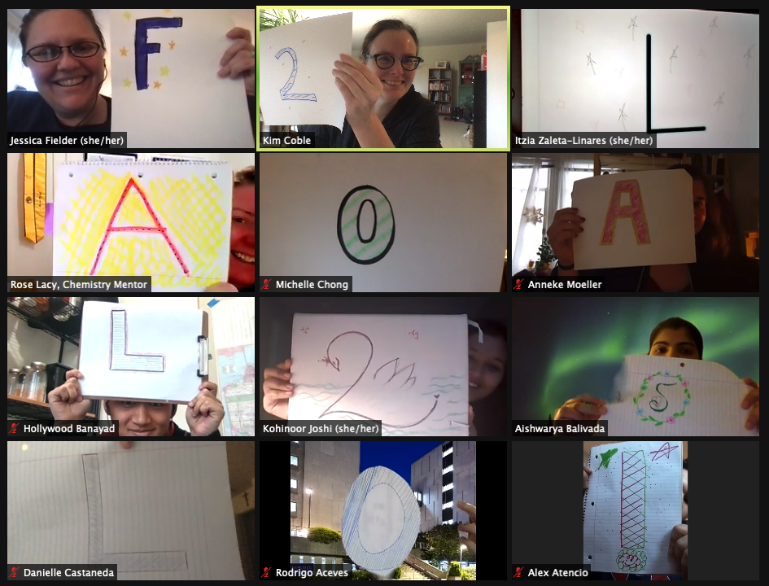
Thanks!
kcoble@sfsu.edu
Notes:
Next steps… IUSE grant with SJSU, SLO

